Slide 1
Safeguarding for community volunteers

Slide 2
What is safeguarding?
Safeguarding is the measures and steps we all take when we are concerned that someone – a child or an adult – is/is likely to be risk of suffering significant harm.
This includes physical, psychological/ emotional, financial, sexual abuse and grooming and neglect. It’s important to be able to recognise the signs so that you or your volunteers can stay safe, and know how to alert the relevant authorities who can then take action to make sure people are safe in your community.

Slide 3
Safeguarding and DBS
We know that many people will want to volunteer to support their local communities, either individually or as part of an organised group. There are many ways to help, but it is important it is done safely for all involved.
Many of the roles that volunteers will carry out in their local communities do not raise safeguarding issues and do not need a DBS check. The Government DBS eligibility guidance will confirm whether the activities your group propose to do require a DBS.
If you are providing care or to help a vulnerable person, you should still be following social distancing rules where possible.

Slide 4
Safeguarding and DBS
As part of volunteering, you may see something that concerns you about the welfare or safety of someone in your community. It is important that we put the structures in place to keep each other safe during this period.
The Government recommends that someone amongst your group takes the lead for keeping you and the people you seek to support safe. This role is so important to ensuring the informal activity taking place is done in a way that doesn’t make the problem worse, or cause more risks for those involved.

Slide 5
Regardless of the activities being undertaken, you should ensure your group follows simple, practical precautions such as:
working safely in pairs
keeping records of money spent
providing shopping receipts
This helps to safeguard all involved.

Slide 6
What to do ?
Follow the principles of :
Stay safe
See it
Recognise it
Report it
Possible signs and symptoms which can indicate harm or abuse are many and varied, and recognising these is an important part of keeping safe in volunteering.

Slide 7
Safeguarding Children

Slide 8




There are Four Types of Child Abuse
Physical
Emotional
Sexual
Neglect

Slide 9
Physical abuse may involve hitting, shaking, throwing, poisoning, burning or scalding, drowning, suffocating, or otherwise causing physical harm to a child. Physical harm may also be caused when a parent or carer fabricates the symptoms of, or deliberately induces illness in a child.
(Source- Working Together to Safeguard Children, 2018)

Slide 10
Common sites for accidental injury
Forehead
NB this does not include pre-mobile babies
Nose
Chin
Shoulders
Bony spine
Elbows
Hips
Forearms
Knees
Shins

Slide 11
Sites of possible non-accidental injury
Head injuries (fractures)
Bruised eyes
Ears (bruises, tears)
Mouth (bruises, tears)
Bruises, grasp marks on arms, shoulders and neck
Chest bruised with grasp marks or by implements
Cigarette burns
Twisting fractures
Abdomen
Buttocks (Bruising or scalds)
Thighs (Bruising or scalds)

Slide 12
Sexual Abuse -
Sexual abuse involves forcing or enticing a child or young person to take part in sexual activities, not necessarily involving a high level of violence, whether or not the child is aware what is happening. The activities may involve physical contact, including assault by penetration (e.g. rape or oral sex)or non-penetrative acts such as masturbation, kissing, rubbing or touching outside of the clothing.
They may include non-contact activities, such as involving children in looking at, or in the production of, sexual images, watching sexual activities, encouraging children to behave in sexually inappropriate ways, or grooming a child in preparation for abuse (including via the internet). Sexual abuse is not solely perpetrated by adult males. Women can also commit acts of sexual abuse, as can other children.

Slide 13
Emotional Abuse
Persistent emotional maltreatment of a child such as to cause severe and adverse effects on the child’s emotional development.
Cant you do anything right?
I wish you were dead
I wish you had never been born
Worthless!

Slide 14
Babies & Young Children may | Older Children May
Be wary or Anxious | Struggle to control emotions
Be overly-affectionate | Lack social skills/ friends
Not show signs of attachment to parents | Seem Isolated from parents
Be aggressive or nasty to other children or animals | Use language/act/ know about things you wouldn’t expect for their age

Slide 15
Neglect
Neglect is the persistent failure to meet a child’s basic physical and/or psychological needs, likely to result in the serious impairment of the child’s health or development.
Neglect may occur in pregnancy as a result of maternal substance misuse.

Slide 16
How to deal with a disclosure

Slide 17
If a child discloses abuse
If you're in a situation where a child discloses abuse to you, there are a number of steps you can take.
Listen carefully to the child. Avoid expressing your own views on the matter. A reaction of shock or disbelief could cause the child to 'shut down', retract or stop talking
Let them know they've done the right thing. Reassurance can make a big impact to the child who may have been keeping the abuse secret

Slide 18
If a child discloses abuse
Tell them it's not their fault. Abuse is never the child's fault and they need to know this
Say you believe them. A child could keep abuse secret in fear they won't be believed. They've told you because they want help and trust you'll be the person to believe them and help them

Slide 19
Don't promise to keep a secret
Explain what you'll do next
Don't delay reporting the abuse

Slide 20
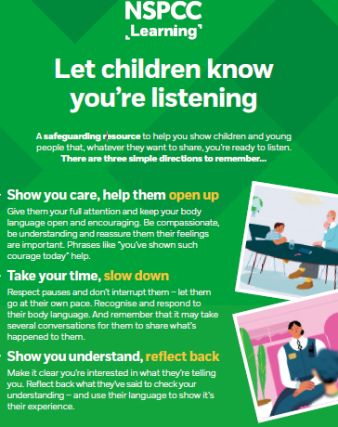
https://learning.nspcc.org.uk/media/1638/let-children-know-listening-poster-english.pdf

Slide 21
WHAT TO DO IF YOU ARE CONCERNED ABOUT A CHILD:
Discuss with someone senior who is helping run the community work/ the safeguarding lead
Decide what action is to be taken – is the child suffering or likely to suffer significant harm or is he/she in need of Early Help?

Slide 22
Early Help
Most children and young people do not need Children’s Social Care intervention, they can be helped through “Early Help”
earlyhelp@peterborough.gov.uk
early.helphub@cambridgeshire.gov.uk

Slide 23
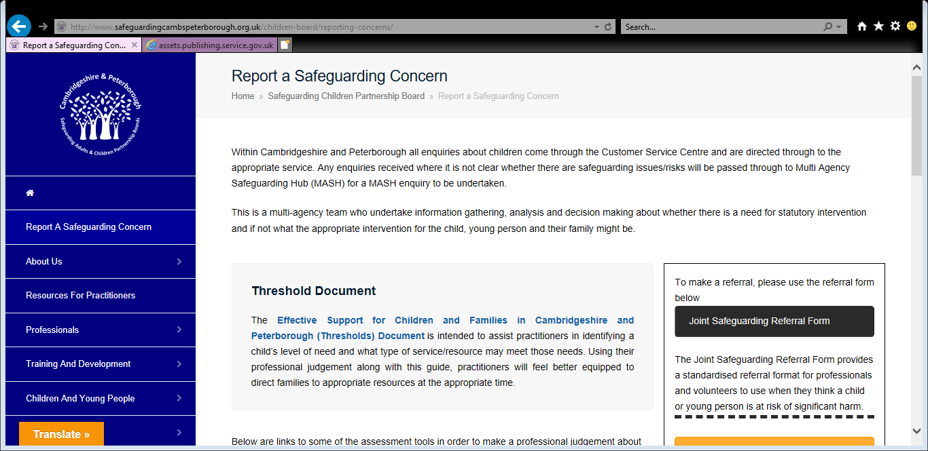
If you do need to refer children’s social care

Slide 24
Reporting Child Protection Concerns to the Local Authority
If you are concerned that a child may be suffering physical, sexual or emotional abuse or neglect or is at risk of significant harm you should telephone Children Services using one of the following numbers:
Cambridgeshire children: 0345 045 5203
Peterborough children: 01733 864180 or
Out of Hours Emergency Duty Team (EDT): 01733 234724
As a professional you can report a safeguarding concern using the Cambridgeshire & Peterborough Safeguarding Referral Form. Email to: ReferralCentre.Children@cambridgeshire.gov.uk
All telephone referrals will need to be followed up in writing within 24 hours by the referring professional

Slide 25
Making a Child Protection Referral
Include as much information as possible. The quality of a referral significantly impacts on how effectively Children Social Care is able to respond to safeguarding.
With poor information, Children Social Care is unable to make appropriate and proportionate decisions. This can put a child or young person at risk OR lead to overly intrusive interventions which are disruptive to the child and/or family

Slide 26
Children worried about Coronavirus
The NSPCC has created a new webpage with information and advice for parents or carers who are worried a child or young person may be struggling with their mental health or has anxiety about Coronavirus. The webpage includes information on: talking about feelings and worries; keeping in touch and balancing screen time; ways to create structure and routine; and helping to give children a sense of control.
https://www.childline.org.uk/info-advice/your-feelings/anxiety-stress-panic/worries-about-the-world/coronavirus/

Slide 27
Domestic abuse

Slide 28
Domestic Violence and self isolation
Government’s advice on self or household-isolation will have a direct impact on victims of domestic abuse. Home is not likely to be a safe place for survivors of domestic abuse and their children. Social distancing and self-isolation could be used as a tool of coercive and controlling behaviour by perpetrators, and will shut down routes to safety and support.
The National Domestic Abuse Helpline continues to operate 24/7 on 0808 2000 247

Slide 29
Domestic Violence and self isolation
There is also a form you can complete online and they will call you back at a safe time https://www.nationaldahelpline.org.uk/Contact-us
Women's Aid online chat is still open https://chat.womensaid.org.uk/
And Men's Advice line, for male victims, is still open too https://mensadviceline.org.uk/

Slide 30
Domestic Violence and self isolation
Locally, Outreach Services are still available too:
Cambridge City/East Cambs/South Cambs 01223 361214
Fenland/Hunts/Peterborough 07787 255821
For support around sexual violence, local Rape Crisis Helplines are closed but National Rape Crisis is still available and they also have online chat https://rapecrisis.org.uk/
And The Elms Sexual Assault Referral Centre is still open https://www.theelmssarc.org/

Slide 31
Adult safeguarding

Slide 32
Safeguarding means protecting an adult’s right to live in safety, free from abuse and neglect.
It is about people and organisations working together to prevent and stop both the risks and experience of abuse or neglect,
While at the same time making sure that the adult’s wellbeing is promoted including, where appropriate, having regard to their views, wishes, feelings and beliefs in deciding on any action.
Care and Support Statutory Guidance, available at:
https://www.gov.uk/government/publications/care-act-statutory-guidance/care-and-support-statutory-guidance

Slide 33
MSP
Making safeguarding personal- making sure that the adult’s wishes, thoughts and feelings are taken into account when considering how to reduce risk or stop abuse from happening.

Slide 34

Who is an Adult with Safeguarding Needs?
Also called An ‘adult at risk’
Previously called a ‘vulnerable adult’

Slide 35
An Adult with Safeguarding Needs:
Has care and support needs
Is experiencing or at risk of abuse or neglect
3. As a result of those care and support needs, is unable to protect themselves from the risk or experience of abuse or neglect.

Slide 36
Care and Support Needs
a physical disability, a learning disability or a sensory impairment
mental health needs, including dementia or a personality disorder
long-term health condition
substances or alcohol misuse to the extent that it affects ability to manage day-to-day living.

Slide 37
There are 10 Types of Adult Abuse
Physical
Sexual
Neglect/ Acts of Omission
Psychological
Financial/
Material
Domestic
Organisational
Discriminatory
Modern Slavery
Self Neglect

Slide 38
10 Types of abuse
For descriptions of each type of abuse, see:
Cambridgeshire and Peterborough Multi Agency Safeguarding Procedures, section 1.4, http://www.safeguardingcambspeterborough.org.uk/wp-content/uploads/2018/11/CPSAB-Multi-agency-Safeguarding-Adults-Procedures.pdf#page=7,
SCIE: https://www.scie.org.uk/safeguarding/adults/introduction/types-and-indicators-of-abuse

Slide 39
Shielding, Social Distancing and Increased Risk
Whilst Social Distancing measures are necessary to contain the spread of Covid-19, the same measures may increase risks for adults at risk of abuse.
Home is not likely to be a safe place for adults who are abused by a family carer. Social distancing and self-isolation could be used as a tool of coercive and controlling behaviour by perpetrators, and will shut down routes to safety and support.

Slide 40
Support for Carers
Pressure on family carers is likely to increase, with stay at home policies and scarcity in resources designed to support carers.
Caring together is offering phone based and online support for carers in the meantime:
https://www.caringtogether.org/coronavirus-covid-19

Slide 41
Indicators
These are the things that you might see, hear, smell or feel that would make you wonder if someone is being abused or neglected
This includes things like bruises and marks of physical abuse, as well as changes in demeanour, activity, weight, appearance/presentation

Slide 42
If you spot indicators of abuse, what do you do?
Ask.
Make sure it is safe to do so
Be genuine
Be specific

Slide 43
If someone tell you about abuse
Listen
Acknowledge
Find out what they want to have happen next
Explain that you need to tell someone

Slide 44

Remember that the adult has special insight into their own situation.

Slide 45
If you believe the adult is in immediate risk
999

Slide 46

Go at their pace
Remember,
The adult may need time to process
They may have different priorities
They may not want help
They may not want help right now
It can take time to establish trust

Slide 47

If someone discloses abuse:
Do not press the person for more details
Do not stop someone who is freely recalling significant events
Do not dismiss what you have been told
Do not promise to keep secrets; but do explain that the information will only be passed to those who "need to know", and try to be specific about who these might be
Do not tell anybody who doesn't need to know – remember the rules of confidentiality
Do not make promises that you cannot keep
Do not contact the alleged abuser or anyone who might be in touch with him / her
Do not ask leading questions

Slide 48
Other sources of Support
Sometimes adults don’t want a safeguarding concern raised, but are willing to accept help from other sources. (Including you, their GP, the community, etc.)

Slide 49
Record
What the adult at risk has told you (using their own words where possible)
Who was involved
The impact of the abuse on the adult
What steps have been taken to protect the adult
Name and signature of the person making the record

Slide 50
Who is your Adult Safeguarding Lead?
You should discuss any concerns you have about an adult with your volunteer coordinator. They should support you to:
Talk to the adult you are concerned about
Record what you know
Plan how to support the adult
Raise a safeguarding concern with the Local Authority if appropriate

Slide 51
What is the MASH?
M
A
S
H
The MASH is responsible for deciding what happens to concerns raised with the local authority. This decision will reflect the desired outcomes of the adult at risk and will take one of three routes:
No further action required by LA- information and advice provided
Formal Safeguarding Enquiry, carried out by the organisation
Formal Safeguarding Enquiry lead by LA or designated partners
ulti
gency
afeguarding
ub
Information about MASH triage and assessment criteria can be found in the Multi Agency Safeguarding Procedures, available here: http://www.safeguardingpeterborough.org.uk/adults-board/information-for-professionals/cpsabprocedures/

Slide 52
Making a referral
Cambridgeshire and Peterborough Adults Safeguarding Referral Form, available at:
https://www.safeguardingcambspeterborough.org.uk/adults-board/reporting-a-concern/

Slide 53
Reporting Concerns to the Local Authority
Cambridgeshire County Council
Telephone: 0345 045 5202 Minicom: 01480 376 743
Fax: 01480 498 066 Text: 07765 898 732
Email: referral.centre-adults@cambridgeshire.gov.uk
Peterborough City Council
Telephone: 01733 747474
Email: adultsocialcare@peterborough.gov.uk
Emergency Duty Team: 01733 234 724
Out of Hours
Emergency Duty Team: 01733 234 724

Slide 54
Protect the Person
If the adult is in danger of repeated significant harm or has just been the victim of a serious crime – call the police 999
If the adult needs urgent medical attention, call 999

Slide 55
Further information
Additional information and resources on safeguarding can be found at;
www.safeguardingcambspeterborough.org.uk

